Slide 1
Lecture 4
8086 Microprocessor.

Slide 2
The 8086/8088 Microprocessors: Registers
Registers
  Registers are in the CPU and are referred to by specific names
  Data registers
    Hold data for an operation to be performed
    There are 4 data registers (AX, BX, CX, DX)
  Address registers
    Hold the address of an instruction or data element
    Segment registers (CS, DS, ES, SS)
    Pointer registers (SP, BP, IP)
    Index registers (SI, DI)
  Status register
    Keeps the current status of the processor
    On an IBM PC the status register is called the FLAGS register
  In total there are fourteen 16-bit registers in an 8086/8088

Slide 3
Data Registers: AX, BX, CX, DX
Instructions execute faster if the data is in a register
AX, BX, CX, DX are the data registers
Low and High bytes of the data registers can be accessed separately
  AH, BH, CH, DH are the high bytes
  AL, BL, CL, and DL are the low bytes
Data Registers are general purpose registers but they also perform special functions
AX
  Accumulator Register
  Preferred register to use in arithmetic, logic and data transfer instructions because it generates the shortest Machine Language Code
  Must be used in multiplication and division operations
  Must also be used in I/O operations

Slide 4
BX
  Base Register
  Also serves as an address register
  Used in array operations
  Used in Table Lookup operations (XLAT)
CX
  Count register
  Used as a loop counter
  Used in shift and rotate operations
DX
  Data register
  Used in multiplication and division
  Also used in I/O operations

Slide 5
Pointer and Index Registers
Contain the offset addresses of memory locations
Can also be used in arithmetic and other operations
SP: Stack pointer
  Used with SS to access the stack segment
BP: Base Pointer
  Primarily used to access data on the stack
  Can be used to access data in other segments
SI: Source Index register
  is required for some string operations
  When string operations are performed, the SI register points to memory locations in the data segment which is addressed by the DS register. Thus, SI is associated with the DS in string operations.

Slide 6
DI: Destination Index register
  is also required for some string operations.
  When string operations are performed, the DI register points to memory locations in the data segment which is addressed by the ES register. Thus, DI is associated with the ES in string operations.
The SI and the DI registers may also be used to access data stored in arrays

Slide 7
Segment Registers - CS, DS, SS and ES
Are Address registers
Store the memory addresses of instructions and data
Memory Organization
  Each byte in memory has a 20 bit address starting with 0 to 2²⁰-1 or 1 meg of addressable memory
  Addresses are expressed as 5 hex digits from 00000 - FFFFF
  Problem: But 20 bit addresses are TOO BIG to fit in 16 bit registers!
  Solution: Memory Segment
    Block of 64K (65,536) consecutive memory bytes
    A segment number is a 16 bit number
    Segment numbers range from 0000 to FFFF
    Within a segment, a particular memory location is specified with an offset
    An offset also ranges from 0000 to FFFF

Slide 8
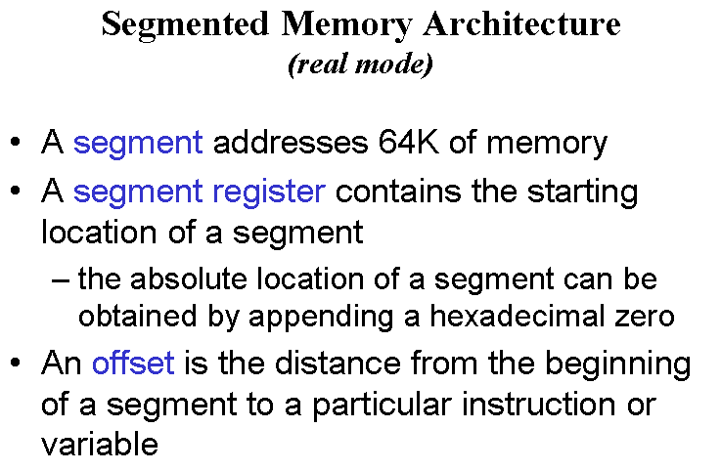

Slide 9

Segmented Memory
Segmented memory addressing: absolute (linear) address is a combination of a 16-bit segment value added to a 16-bit offset
one segment
linear addresses

Slide 10

Intel
Memory Address Generation
The BIU has a dedicated adder for determining physical memory addresses
Offset Value (16 bits)
Segment Register (16 bits)
0 0 0 0
Adder
Physical Address (20 Bits)

Slide 11
Intel
Example Address Calculation
If the data segment starts at location 1000h and a data reference contains the address 29h where is the actual data?
2
9
Offset:
0 0 0 0 0 0 0 0 0 0 1 0 1 0 0 1
Segment:
0 0 0 1 0 0 0 0 0 0 0 0 0 0 0 0
0 0 0 0
Address:
0 0 0 1 0 0 0 0 0 0 0 0 0 0 1 0
1 0 0 1

Slide 12
Segment:Offset Address
Logical Address is specified as segment:offset
Physical address is obtained by shifting the segment address 4 bits to the left and adding the offset address
Thus the physical address of the logical address A4FB:4872 is
      A4FB0
      + 4872
      A9822

Slide 13
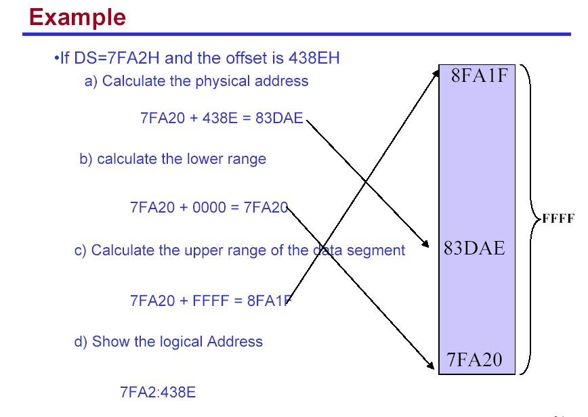

Slide 14
Your turn . . .
What linear address corresponds to the segment/offset address 028F:0030?
028F0 + 0030 = 02920
Always use hexadecimal notation for addresses.

Slide 15
Your turn . . .
What segment addresses correspond to the linear address 28F30h?
Many different segment-offset addresses can produce the linear address 28F30h. For example:
28F0:0030, 28F3:0000, 28B0:0430, . . .

Slide 16
The Code Segment
_{0H}
4000H
CS:
0400H
IP
0056H
4056H
CS:IP = 400:56
Logical Address
Memory
0400
0
Segment Register
Offset
Physical or
Absolute Address
+
0056
04056H
_{0FFFFFH}
The offset is the distance in bytes from the start of the segment.
The offset is given by the IP for the Code Segment.
Instructions are always fetched with using the CS register.
The physical address is also called the absolute address.

Slide 17
The Data Segment
_{0H}
05C00H
DS:
05C0
05C50H
EA
0050
DS:EA
Memory
05C0
0
Segment Register
Offset
Physical Address
+
0050
_{0FFFFFH}
05C50H
Data is usually fetched with respect to the DS register.
The effective address (EA) is the offset.
The EA depends on the addressing mode.

Slide 18
The Stack Segment
_{0H}
0A00
0A000H
SS:
0A100H
SP
0100
SS:SP
Memory
0A00
0
Segment Register
Offset
Physical Address
+
0100
0A100H
_{0FFFFFH}
The offset is given by the SP register.
The stack is always referenced with respect to the stack segment register.
The stack grows toward decreasing memory locations.
The SP points to the last or top item on the stack.
PUSH - pre-decrement the SP
POP - post-increment the SP

